Slide 1
Introduction to Neural Networks

Slide 2
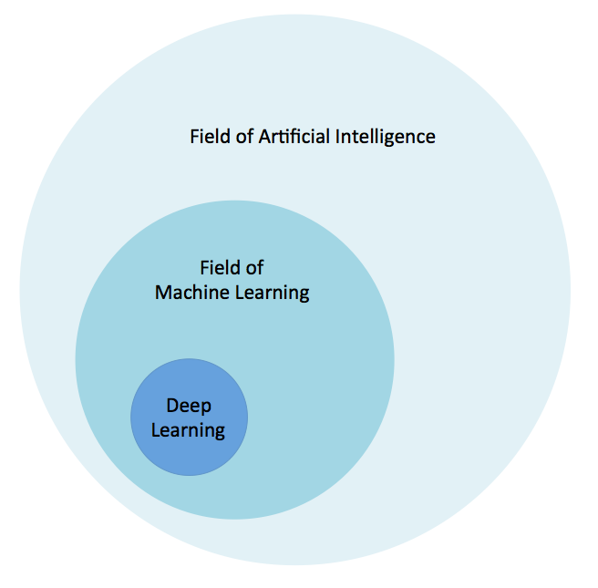
Hierarchy

Slide 3
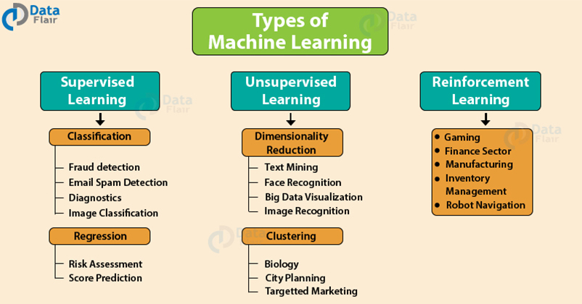

Slide 4
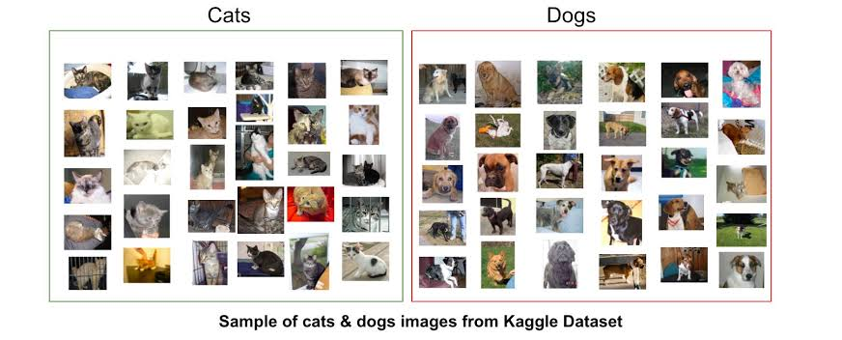

Slide 5
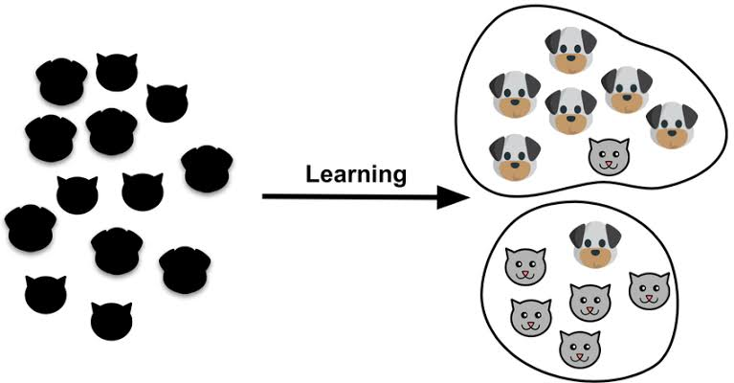

Slide 6
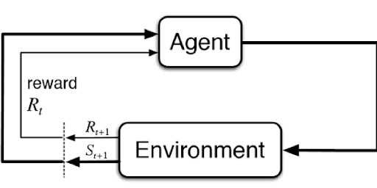

Slide 7
BINARY CLASSIFICATION
Refers to the process of classifying data objects into two subsets based on certain parameters or classification rules.
It is a type of supervised learning.
Types of binary classifiers:
Decision Trees
Random Forests
Logistic Regression
Neural Networks
Bayesian Networks

Slide 8
LOGISTIC REGRESSION
Divides the data into 2 groups – ‘0/Fail’ OR ‘1/Pass’
Applications of such a classifier is found in:
Disease Prediction ( Ill or not)
Email Filtering (Spam or Not)
Image Classifier (Dog (1) or Not (0))

Slide 9
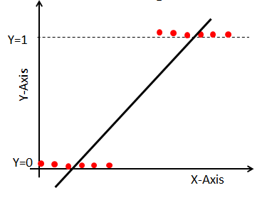
NAÏVE APPROACH
A naïve approach would be fitting a straight curve on the data.

Slide 10
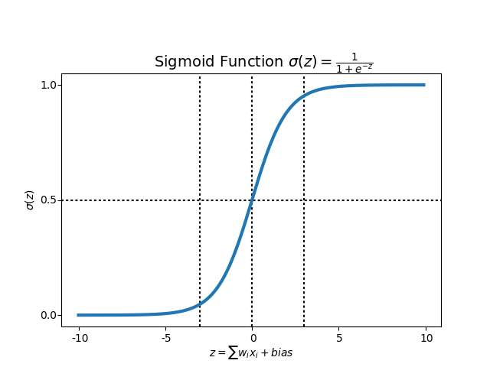
SIGMOID FUNCTION

Slide 11
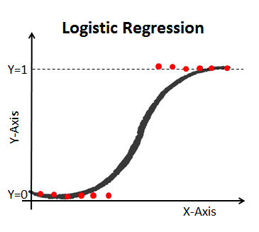
LOGISITIC APPROACH
Model fits the data and takes care of any outliers encounter

Slide 12
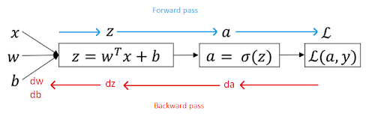
COMPUTATIONAL GRAPH
(LOGISTIC REGRESSSION ARCHITECTURE)

Slide 13
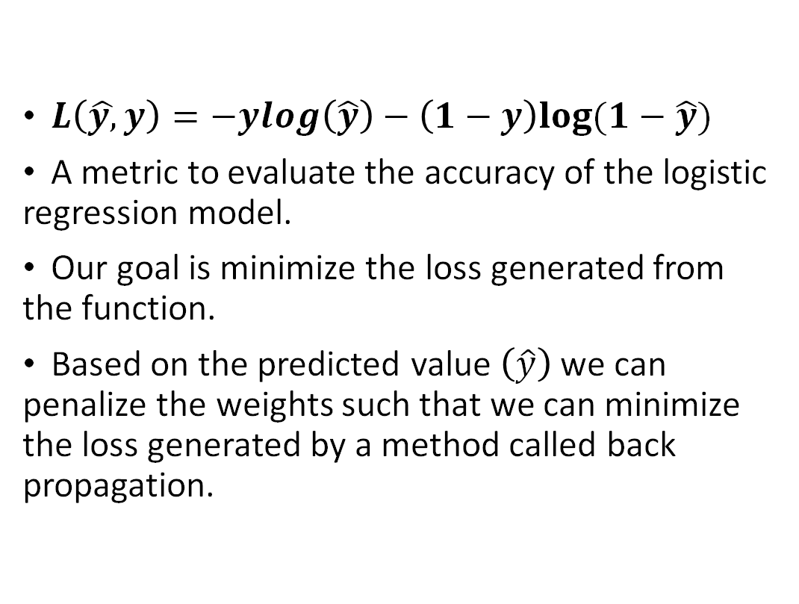
LOSS FUNCTION
$L\left(\hat{y,}y\right)=−ylog\left(\hat{y}\right)−\left(1−y\right)log⁡(1−\hat{y})$
A metric to evaluate the accuracy of the logistic regression model.
Our goal is minimize the loss generated from the function.
Based on the predicted value $\left(\hat{y}\right)$we can penalize the weights such that we can minimize the loss generated by a method called back propagation.

Slide 14
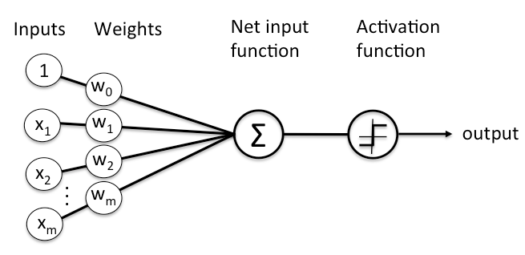
LOGISTIC REGRESSION WITH A NEURAL NETWORK MINDSET

Slide 15
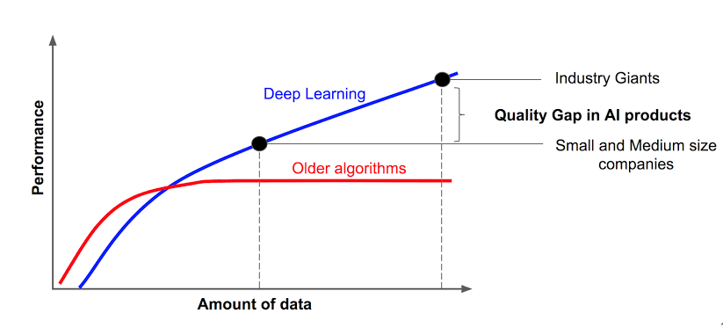
DL vs ML

Slide 16
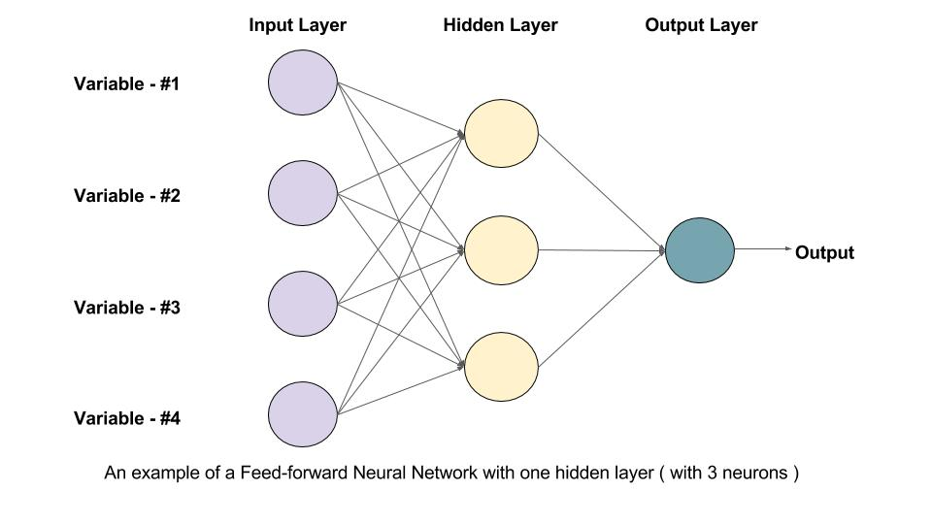
Basic Architecture of NN

Slide 17
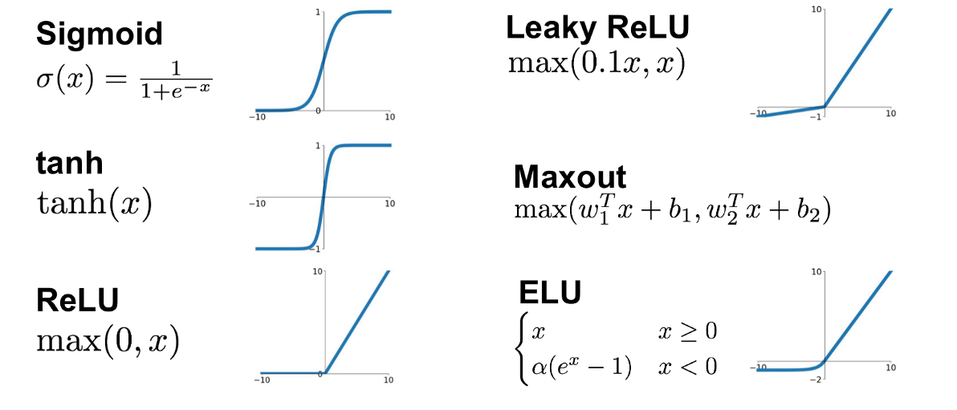

Slide 18
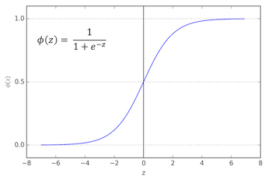
Sigmoid Activation Function

Slide 19
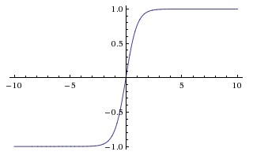
Tanh Activation Function

Slide 20
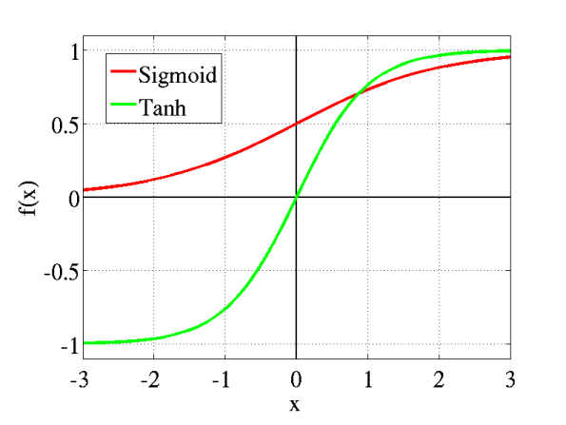
Sigmoid vs Tanh

Slide 21

ReLU Activation Function

Slide 22
COMPUTATIONAL GRAPH
(LOGISTIC REGRESSSION ARCHITECTURE)

Slide 23


Slide 24
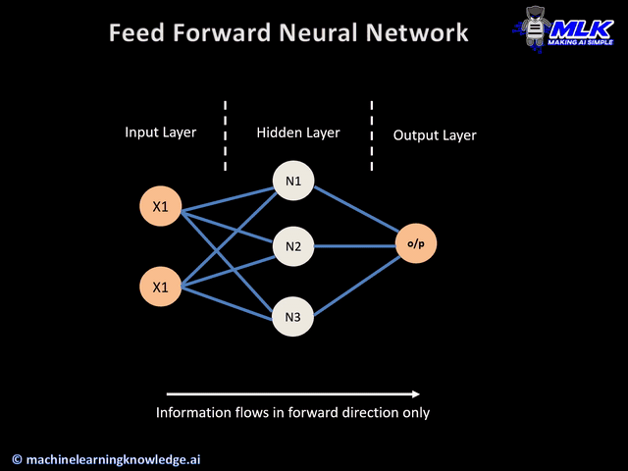

Slide 25
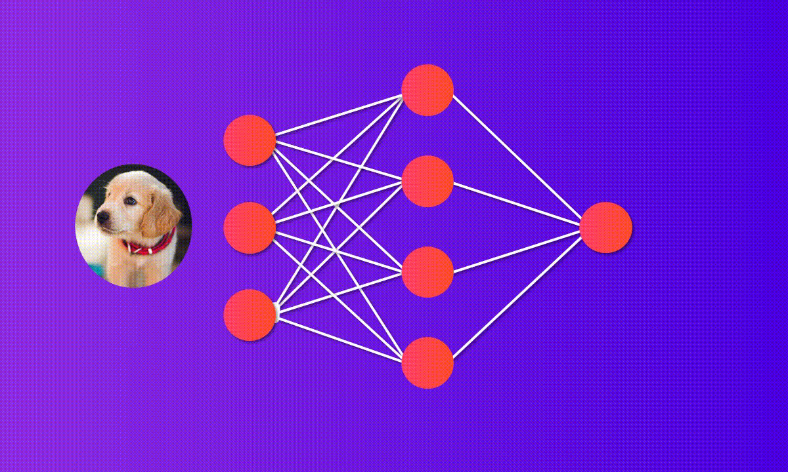

Slide 26
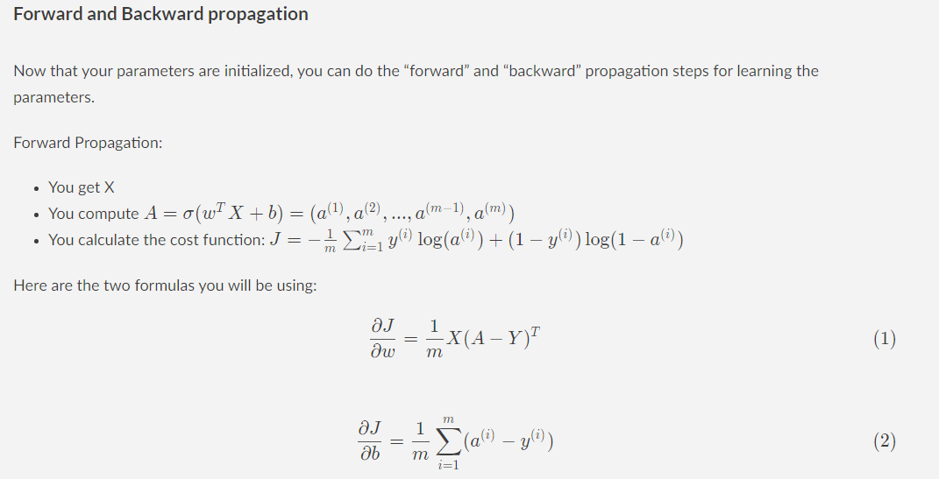

Slide 27
LOSS FUNCTION
$L\left(\hat{y,}y\right)=−ylog\left(\hat{y}\right)−\left(1−y\right)log⁡(1−\hat{y})$
A metric to evaluate the accuracy of the logistic regression model.
Our goal is minimize the loss generated from the function.
Based on the predicted value $\left(\hat{y}\right)$we can penalize the weights such that we can minimize the loss generated by a method called back propagation.

Slide 28

Gradient Descent

Slide 29
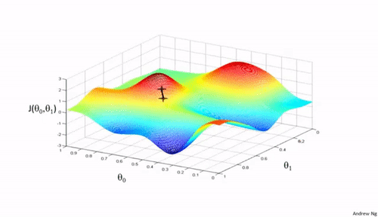
Gradient Descent

Slide 30
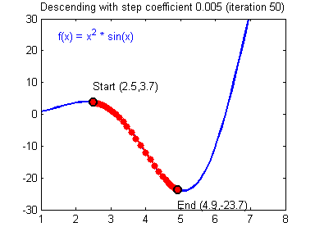
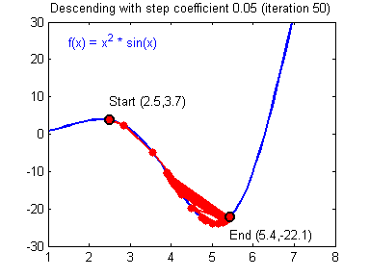
α learning rate

Slide 31
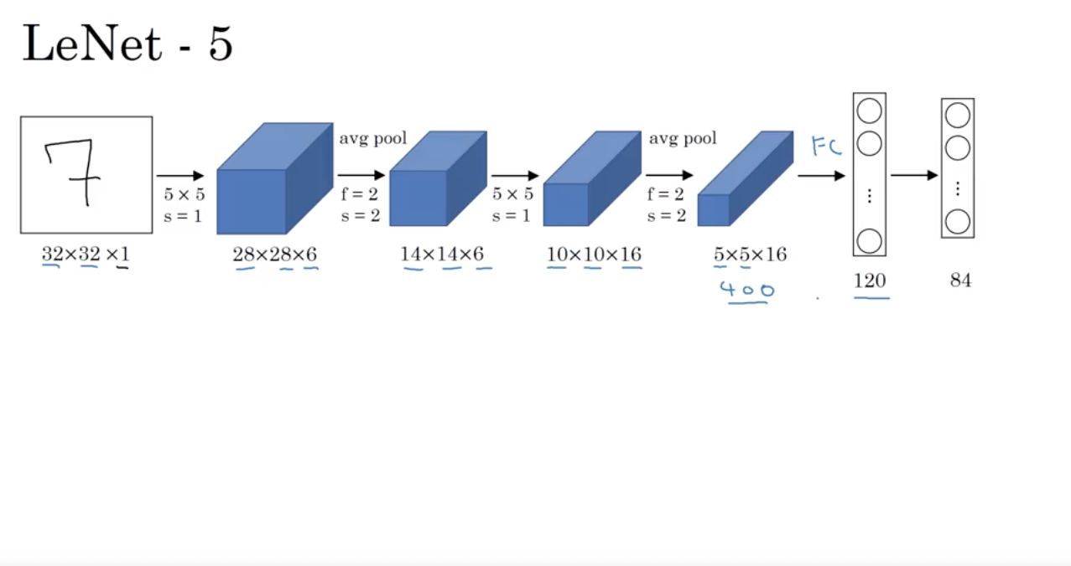

Slide 32
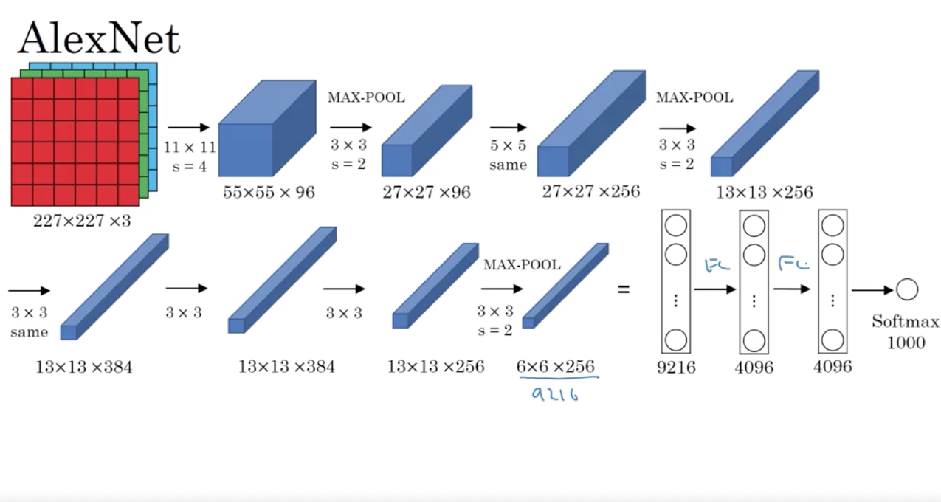

Slide 33
